Slide 1




Project Prosal
House price prediction
IT3160E – Semester 2023.2

Slide 2

Group members
1
Pham Quang Anh
20220071
2
Vu Binh Minh
20226058
3
Ngo Minh Trung
20226004
4
Dang Trong Van
20226072
5
Nguyen Long Vu
20226006

Slide 3


Background
Accurate prediction of house prices
Buyers, Sellers, Investors, Real estate agent
Empower
minimizing risks and maximizing returns in real estate transactions
Uses
Challenging:
data instability, market dynamics, and complex pattern features.
Page

Slide 4
Page
Input & Output
numerical and categorical values (living area, bedrooms, bathrooms,…) organized into tabular form (a .csv or .xlsx file). Data from Bengaluru, India
INPUT
Residental price
The data is split into train and test sets with predetermined proportion, which after testing, the model will return different metrics for evaluation.
OUTPUT

Slide 5
Algorithm
1
Elastic Net Regression
2
Decision Tree
3
Random Forest
4
Gradient Boosting
5
XGB Boost

Slide 6
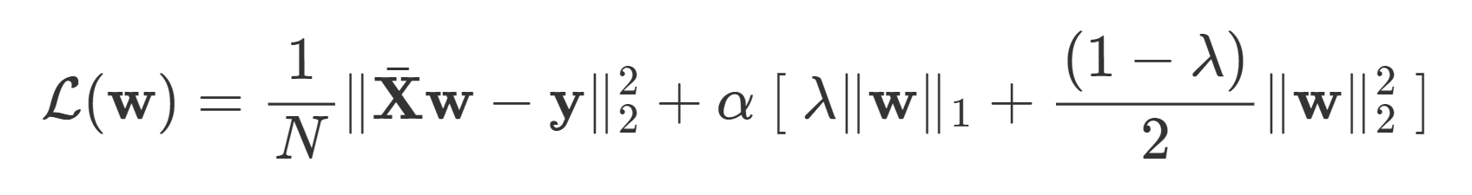
1
Elastic Net Regression
sum of squared residuals
L1 regularization (Lasso)
L2 regularization (Ridge)

Slide 7
2
Decision Tree
Decision Tree is a tree-like structure where each node represents a feature, and the branches represent the decision rules.
Example: 2 features – Location
- Area

Slide 8
Location: Suburban
true
false
Area > 10⁴ sq ft
Area > 2 acres
true
false
true
false

Slide 9
The weakness of Decision Tree (DT) is that they tend to overfit the data and not perform well on the test set.
→ Random Forest is an ensemble learning algorithm that combines the simplicity of DTs.
3
Random Forest

Slide 10
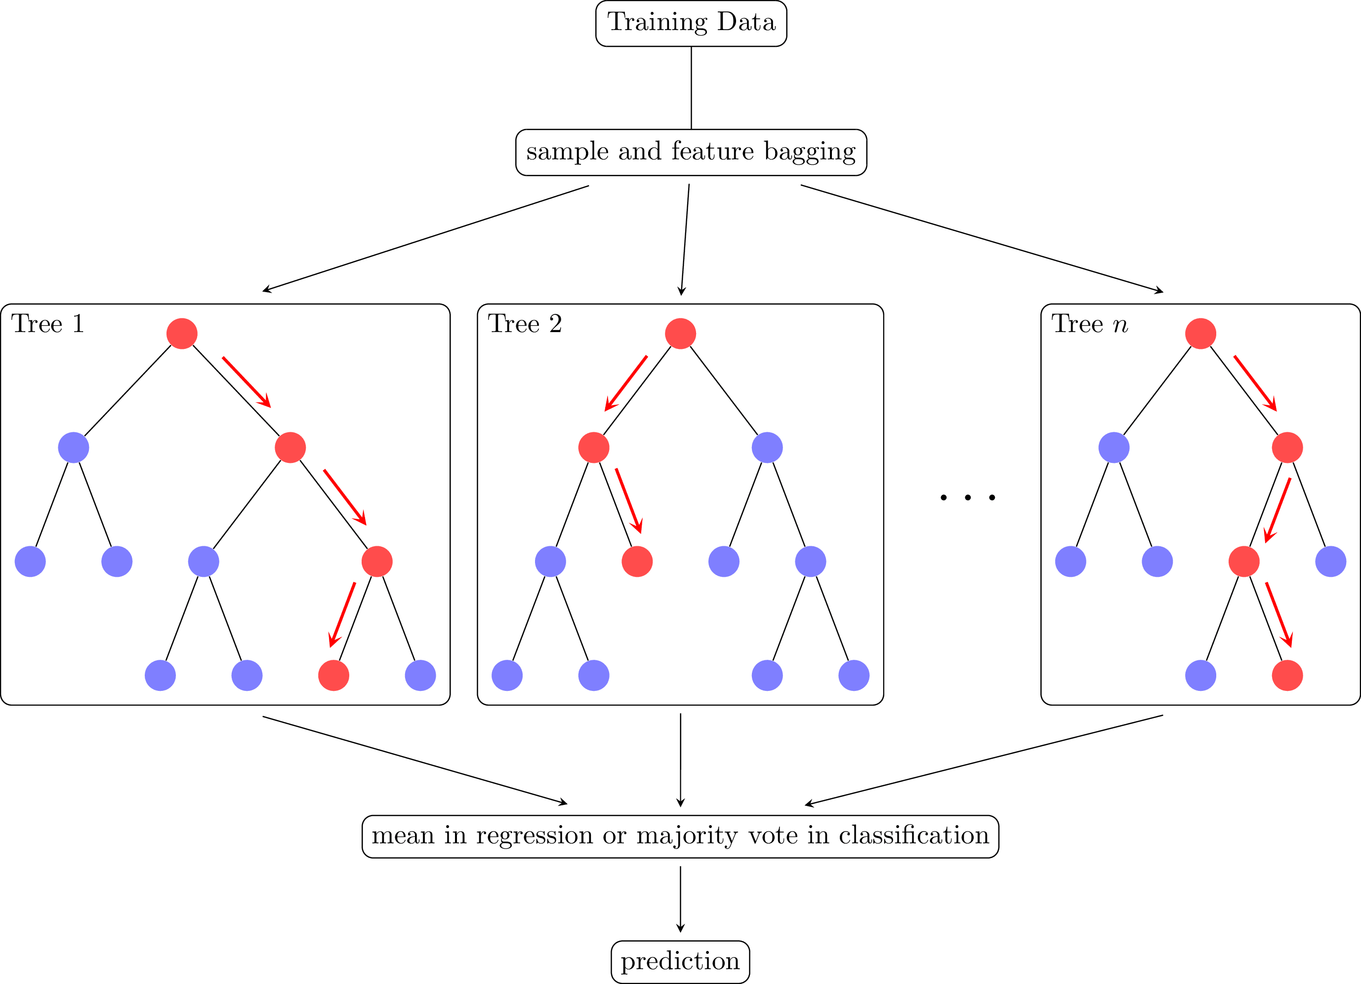

Slide 11
4
Gradient Boosting
Gradient Boosting also combines weak learners like DTs sequentially.
The model needs to have a differentiable loss function to begin with, this case represented by MSE.
Iterate these step:
calculate the gradient step for each sample
(for MSE this is the residual)

Slide 12
Fit a regression tree for the sample to predict the Gradient
Use the newly-created weak-learner to create the new target function
Repeat

Slide 13
5
XGBoost
XGBoost improves the “tree-building” part of Gradient Boosting, by several different methods:
The tree is built based on the gain metric, which is also used to prune the tree
The loss function uses Newton-Raphson method instead of the regular Gradient.
Regularization, by putting penalties to the Output Value

Slide 14
Experiment and Evaluation
Page
Pre-built model
Scikit learn library of python
Evaluation
RMSE (root mean square error)
MAE (mean absolute error)
R-squared (coefficient of determination)

Slide 15
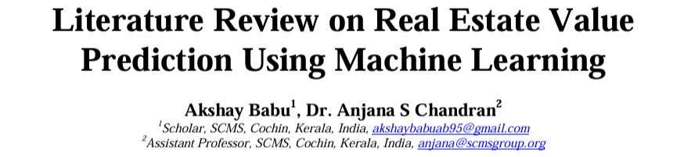
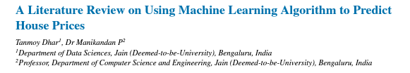
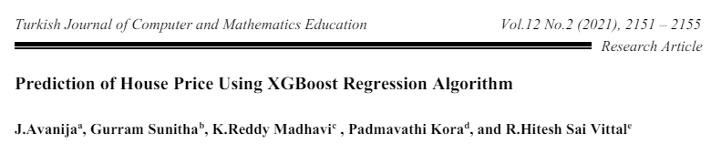
State of art
Page
[1]
[2]
[3]

Slide 16
State of art
Page
Input Data Considerations
Several studies (e.g., [1, 2]) emphasize that the choice of model can influence data considerations. For instance, Random Forest generally handles various data types without extensive preprocessing, while models like Elastic Net (known for feature selection) might benefit from high-dimensional data containing many features.
Performance and Limitations:
Studies consistently report the strong performance of XGBoost in house price prediction tasks. This is attributed to its optimized algorithms and ability to handle complex feature interactions, as discussed in [2, 3] (references).

Slide 17
Page
The interpretability of models is a recurring theme in the literature. Linear Regression offers interpretability but may struggle with complex relationships ([2]). Random Forest and Gradient Boosting offer a balance, while XGBoost and can be challenging to interpret due to their ensemble nature or complex architectures ([1, 2, 3]).
Future Research Directions
Research suggests exploring methods to improve interpretability while maintaining prediction accuracy, particularly for models like Random Forest and XGBoost ([2, 3]).
Further research on feature engineering techniques specifically tailored to house price prediction tasks can benefit various models ([3]).
Developing more interpretable ANN architectures and improving training efficiency for house price prediction remain active areas of research (e.g., [2]).

Slide 18
Conclusion
Both models offer valuable insights and can aid in making decisions in real estate transactions. However, note that the models have their own strengths and limitations, and are intended to approach specific use cases.

Slide 19
Thank
You!

